Slide 1



The Bookaholics
GROUP 10 presents:
by:
Jennifer Bohling, Juan Cantu, KATHERINE GOINS, Jonathan Hocevar, ABHIJEET MEDTIA, Felicity Pawlowski, Noah Sims
Notes:
<begin recording>
Jennifer:
Hello everyone, thank you very much for being here today.
I'm Jennifer Bohling.
I'm Juan Cantu
I'm Kate Goins
I'm Jonathan Hocevar
I'm Abhijeet Medtia
I'm Felicity Pawlowski
I'm Noah Sims
We are group 10 and we are proud to present our work from this semester on our app, The Bookaholics.

Slide 2


What is the bookaholics?
Notes:
Jennifer:
So, what is our app, The Bookaholics about?
As avid readers, we were drawn to the idea of designing a bookshelf app. But we wanted our app to stand apart from the numerous bookshelf apps available and to have more functionality than simply allowing a user to store and read their books. So we decided to design an app which combines aspects of social media with reading.
Have you ever wondered what your friends are reading? Ever wanted to keep a list of the books you have read or want to read later?

Slide 3

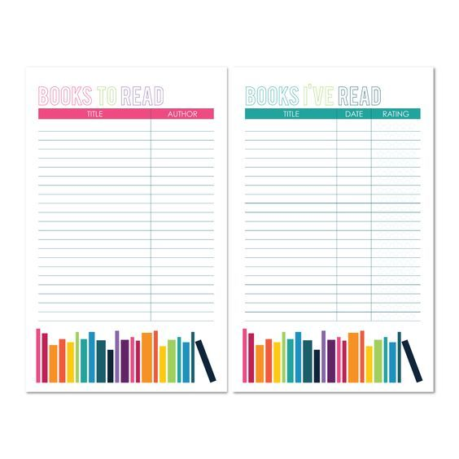

Notes:
Jennifer:
Our app gives users the ability to add friends, write reviews and rate books they have read, and create lists such as what they have read/want to read/and are currently reading.
When a user creates a review or something is added to their list, their friends will be notified. Meaning friends will know which books are going on your list to read, which ones you've finished and might want to discuss, or they can read your reviews to find out what you loved (or hated) reading!

Slide 4
What it's not
Notes:
Jennifer:
In our early design phase, we went back and forth discussing what our app should be and what it should not be.
For example, there are many good apps available for purchasing or downloading books, such as Libby, OverDrive, and Kindle.
After some discussion we decided it was better to focus our efforts on reading and social media aspects, and to have an app which can import books which have been bought or downloaded from other sources.
Now that you know the concept behind The Bookaholics, we will take you through our process, starting with Felicity who will explain our project scheduling.

Slide 5
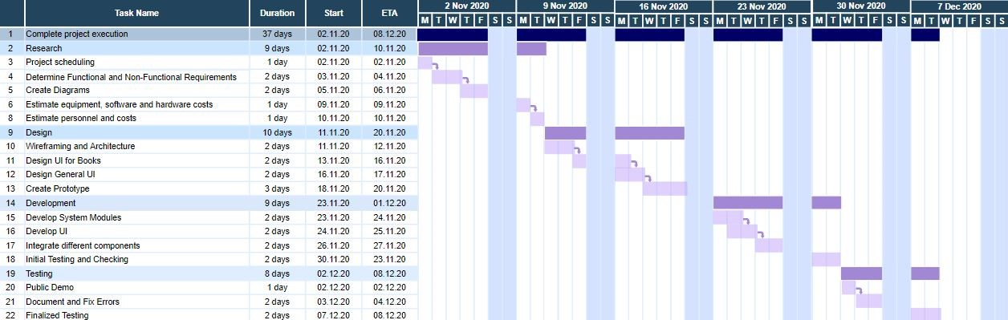
Project scheduling
Using the FP method we calculated the development time to be approximately 7 business days and from that we came up with the above schedule.
Notes:
Felicity: This is our project schedule. We used the assumption of 35 hour work weeks for our calculations as well as 3 team members. This allows for 5 working hours per day per person for the project with weekends off. Using these assumptions with the Function Point method and our estimated effort we found the development duration for our project was an approximate 7 business days. With weekends, this puts the development time for the project at 9 days.
Using this as reference, we went back and were able to approximate the other aspects of the project coming up with about 9 days for research, 10 days for design, the original 9 days for development, and a following 8 days for testing, bringing the total duration for the project to be about 37 days. On the right can be seen the visual breakdown of each task's allotted estimated time. For the purposes of this visual we marked the start date as November 2, 2020 putting the project at an end on December 8, 2020.

Slide 6
FUNCTIONAL REQUIREMENTS
The user should be able to manage the books in their libraries including the ability to view, download, and edit their library.
The user should be able to read the books by flipping through the pages that are shown by the system.
The user should be able to create notations and bookmarks that will be saved to the book’s data on the system
The user should be able to create a profile to write reviews, book recommendations, and to have friends
The user should be able to create and manage different lists of books such as “Currently Reading,” “Want to Read,” and “Finished Reading.”
Notes:
The functional requirements of a project are the features and facilities that must be added in order for the user to use the application properly. To create our functional requirements we asked ourselves what features we liked best from similar apps and what we could add to improve on them. We came up with 5 requirements which included
- the ability to view, download, and edit a users own library.
- Being able to read books in a visually realistic way by flipping through pages.
- Creating notations and bookmarks in the books
- create profiles to write reviews, recommendations, and have friends lists
- Lastly we added a way to manage different book lists

Slide 7
NON-FUNCTIONAL requirements
The Application would adapt to users’ screen without any of the details cutting out.
The Software would stay below the limit of 5MB of system’s RAM
Software would fit under 10MB of space on the user’s device.
The users can control their personal information at any given time.
Notes:
Ace: Hello Everyone Lets jump right on to the Non-functional requirements now
Our application runs on a variety of devices that have different screen sizes and pixel densities. The system performs basic scaling and resizing to adapt to customer’s user interface and ensure our UI gracefully adapts for each type of screen.
Mobile devices always have limited resources. They have a limited amount of battery, limited storage, limited processing power, and limited RAM.
Our software is made with keeping efficiency in mind. Our application would always stay below 5MB of system’s RAM even at high usage.
And it will only take 10MB’s of space for application size
Majority of people feel as if they have little to no control over data collected about them by companies or the Government.
This is definitely not the case with our app. The users will be able to monitor their personal information at any given time.

Slide 8
NON-FUNCTIONAL requirements
All the services shall be always accessible to the user.
Users credential and information shall be kept secure from external access. We care deeply about our user’s security.
Application would be available both on the App Store and the Google Play Store
Notes:
Ace: Keeping security in mind, Users information will always be kept secure from external access.
And at last our App ‘book a holics’ will be made available to download both on the Apple app store and The Google Play Store for free.

Slide 9
Estimated cost
Hardware Cost:
Server Cost: $3,635
Software Product Cost
Cost: $778
Personnel Cost
Cost: $13,440
Notes:
Ace: Coming to the Cost segment of this presentation:
As you can see the personnel cost is going to be our biggest investment towards launching our app.
It comes to around a little under $13500
Our cheapest capital spending will be the cost of Software products which will be about $800

Slide 10
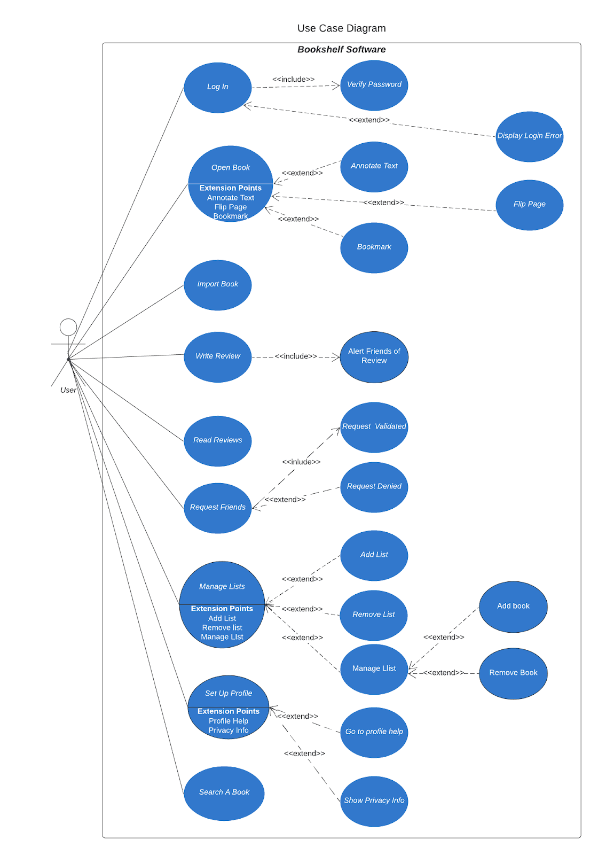
Use Case
The use case diagram breaks down the functional requirements into specific actions the user will take
Most of these actions have extend and include arrows to show the sub actions they can take from there.
Our sequence diagrams were built around each use case on the left column, with the right column being the different actions in the loop/alt boxes.
Notes:
Our use case diagram displays each action the user can take as derived from the functional requirements. Actions include essential things to a bookshelf software such as reading and searching books as well as managing different book lists such as future reads. Some unique actions our user can take are being able to request friends and read and write reviews. Most of these uses cases include sub actions that are taken from the main use case as shown through the extend and include arrows. The main use cases on the left column formed the bases of our sequence diagrams with the right column of use cases being the different actions in the loop and alternative boxes.

Slide 11
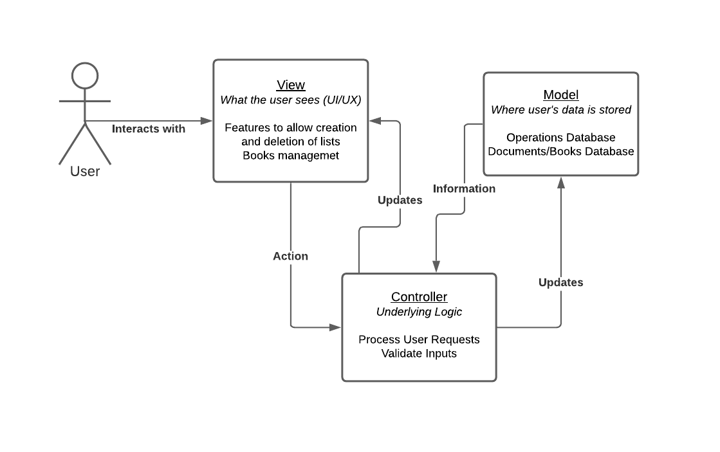
Architectural Design
Controller: Acts as the Brain/Server of the application, passing data from the database the View and handling user inputs
View: What the user sees and interacts with. The main menu, log in screen, profile, book lists
Model: The database that stores our relational tables. Stores book reviews, user profiles and friend lists.
Notes:
Jonathan: For our architectural design, we choose to go with a modified version of the MVS architecture.
Our model uses the same three components,
1. The controller that acts as the brain of the application, processing data from the model and handling user input
2. The view that the user sees and interacts with
3. The model acts as the database and stores the data for the application
We have chosen to have the flow of data go through the controller, thus separating the View and Model components.
The user will interact with the view they see, which will send their actions to the controller, which will then update the view and request data from the model as necessary

Slide 12
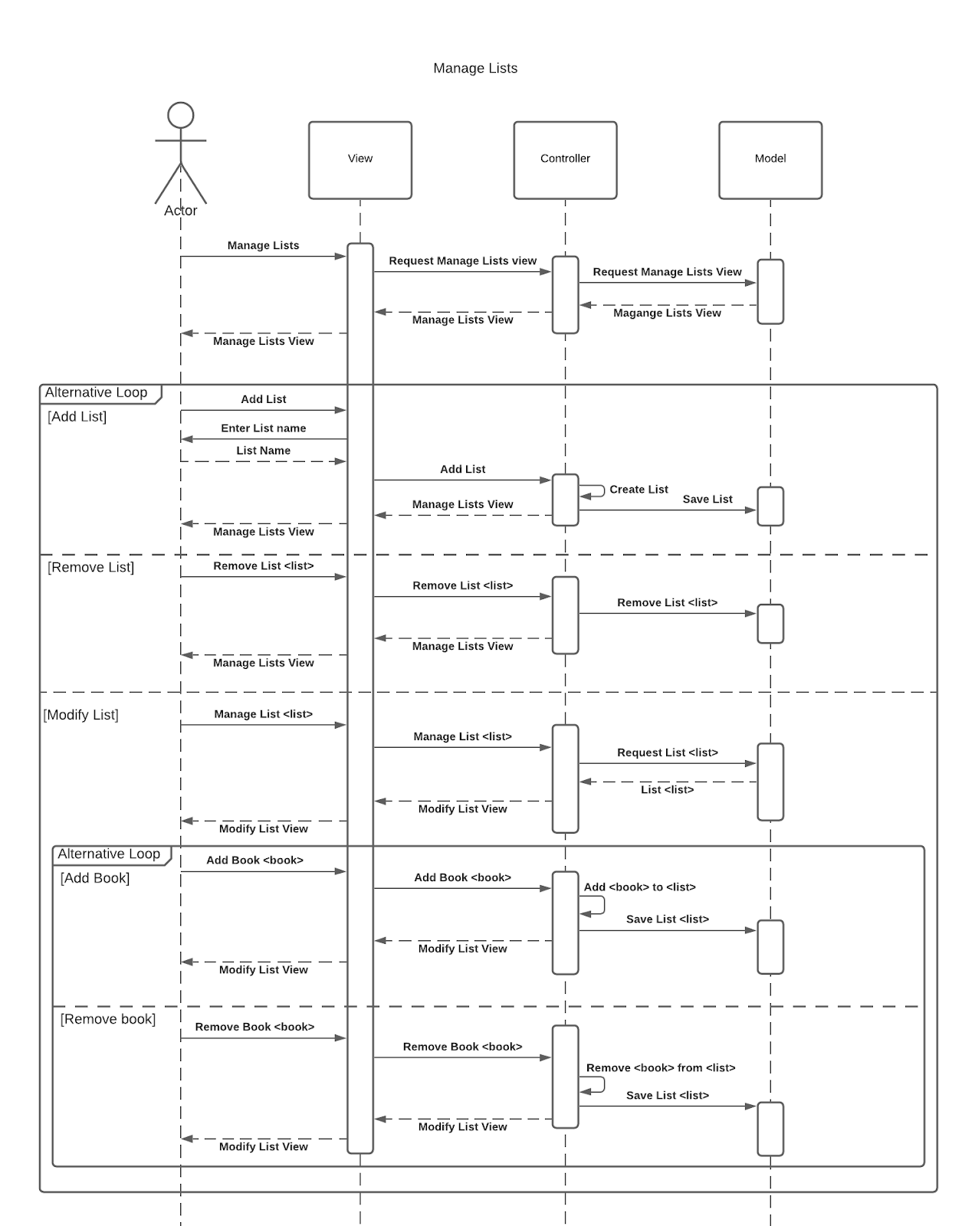
Sequence Diagram
Represent the flow of requests and data through the components of our MVC architecture
The way our architecture was designed, each component only needs talk to the components directly next to itself
For example, the controller acts as the go between for View and Model.
We combine loops and alt boxes to show how the user can use multiple actions on the same page, as long as that action does not take them to a new page
Notes:
We can see our architectural design modeled here in our sequence diagrams.
Each component talks directly to the components directly on either side of itself.
We also combined the alternative and loop blocks to model how the user can use multiple features on the same view window.
This sequence diagram displays the options the user has when managing a list. After adding a list, the user is left in the same position they started and can still add, remove or manage another list.

Slide 13
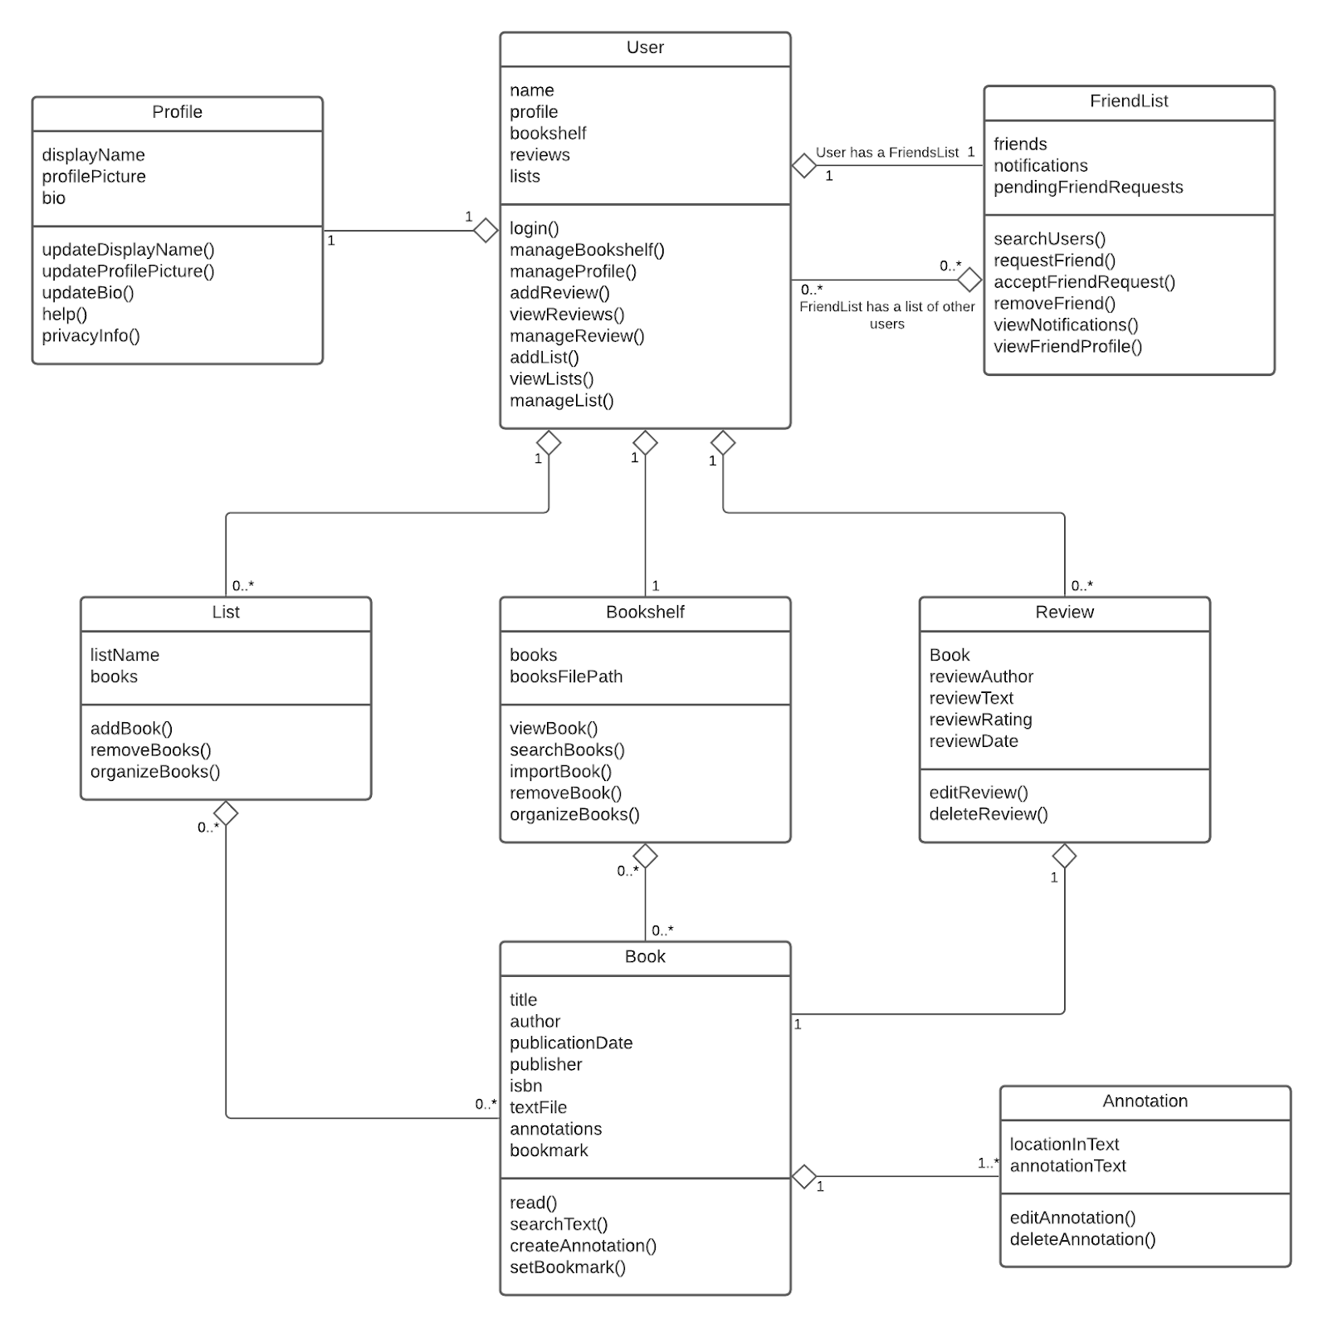
Class Diagram
The class diagram shows each of the classes necessary for our program and how they relate to each other, using an object oriented approach
Each of our functional requirements are represented through the class functions in this diagram
Because this is a user based system, each object is linked to a central user object
Notes:
Noah:
Here we have the class diagram, which describes all of the neccesary classes for our project and their releation to each other, using an object oriented approach.
The functional requirements that we defined earlier are all represented here as functions of the classes, each requirement being an affect on one of these objects.
Because our program was designed around individual users maintaining their own library and book lists, each object can be linked to a central user node, simplying the organization of these objects in the database.

Slide 14
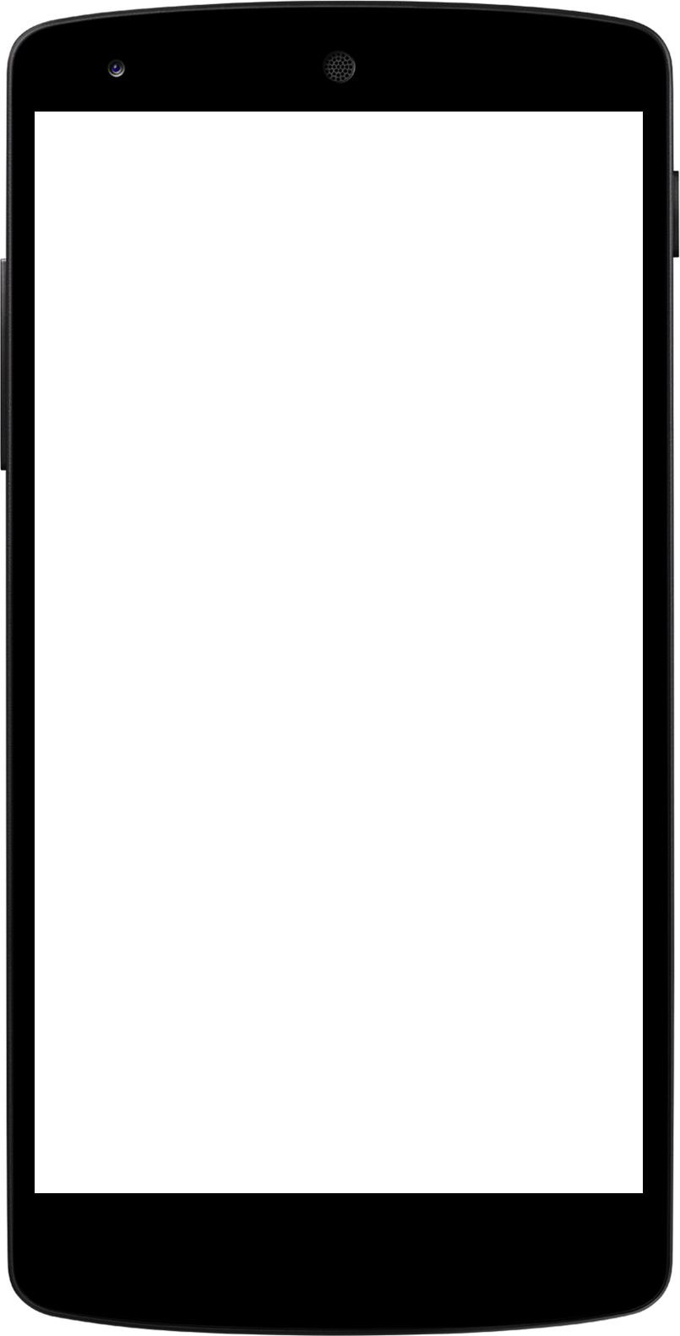
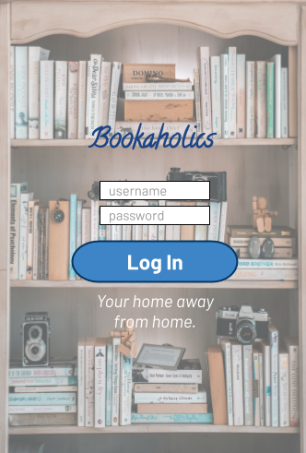
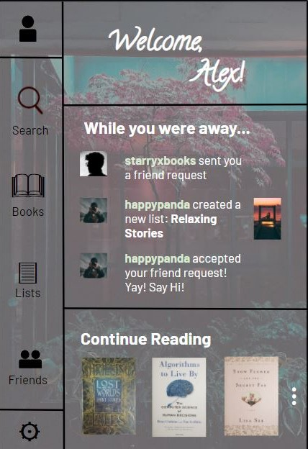
UI DESIGN
Notes:
Felicity: These are two sample user interfaces that were designed specifically for The Bookaholics application. On the left side, we have the log in screen with two textboxes for the user to enter their username and password. On the right side, we have the app's startup homepage. This is the page that will load after a user has logged in. For this visual we are assuming that a user with the name of Alex has just logged into their account.
This is what a user could expect to see.
Under the greeting for the user are any notifications that may have been received while away. Under this will be any books that the user is in the process of reading, this is so if the user's intent it to just pick up from where they left off in a book they can do so quickly. On the left hand side of the screen are icons representing, from top to bottom, profile, search, books, lists, friends, and settings. The user can click on any of these icons, one of the stories they are currently reading, or a notification to advance to the next desired screen.

Slide 15
Thank you
Notes:
Jennifer:
Thank you for coming today. We had a wonderful experience designing our software and working together as a team this semester.
We learned a lot about software design through our project and how to collaborate with fellow developers.
This concludes our presentation. Thank you very much for your time.
<end recording>

